Slide 1

Employees Grievances

Slide 2
“dissatisfaction which is mostly related to work.”

Slide 3
“Grievance is an ‘Employee’s complaint’ against management.”
Expert says,” A method for employees to use to resolve conflicts when they feel they have been treated unfairly by management.”

Slide 4
Causes or Sources of Grievances
Employees Point of View
Management’s Point of view

Slide 5

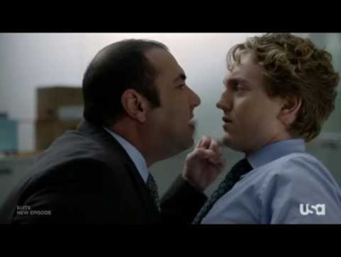

A. Employee Point of view
Concerning wages-too less of wages or salary.
Concerning Supervision-Picking on an employee, inadequate instructions
Concerning Individual Advancement-unfair promotions, no appreciation

Slide 6
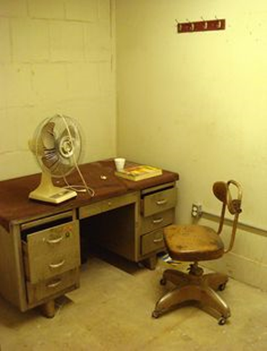
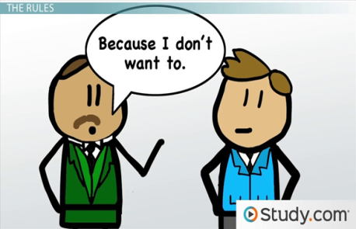


General Working Conditions-damp office rooms ,unhygienic facilities of canteen and toilets
Collective Bargaining-decline previous union agreements
Management Practices-unequal distribution of power, misuse of authority
Union Practices-more than one union

Slide 7
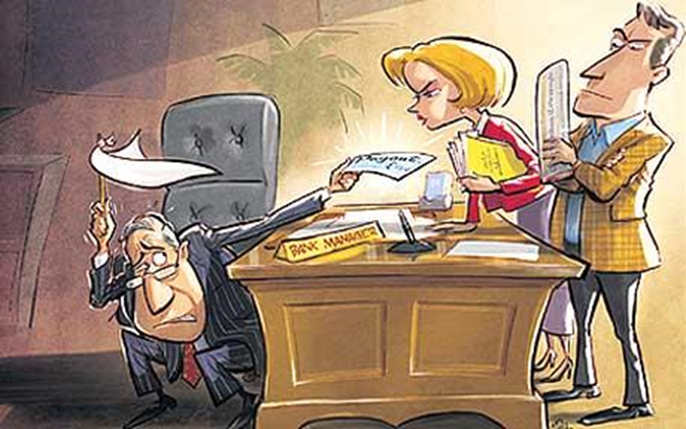
B. Management’s Point of View
a) Indiscipline
b) Go Slow Tactics
c) Non-fulfillment of the terms of contract signed
d ) Failures of trade union to live up to its promises
e) Irresponsible charges made in the form of Public speeches,etc.

Slide 8
Grievances Handling

Slide 9
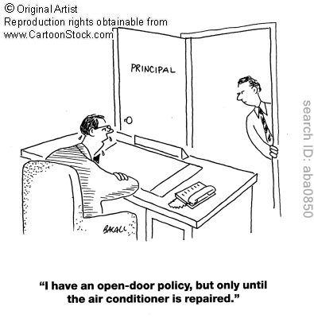

Slide 10
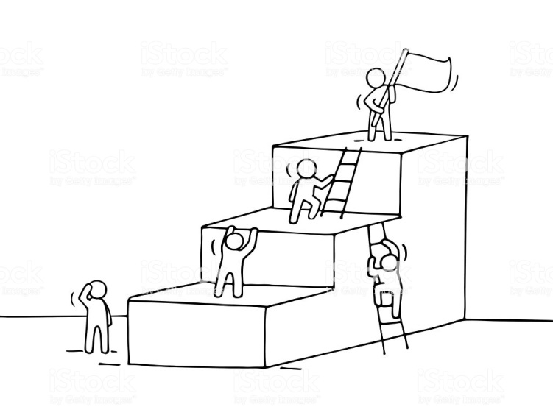
Step Ladder Approach

Slide 11
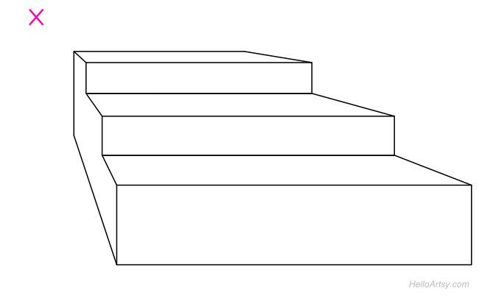
Step 5: Arbitration
Step 4: Approaching company HR officer
Step 3: Approaching the Grievance Committee
Step 2: Written Complains
Step 1: Verbal Complains

